Slide 1
LOTR Lord-Of-The-Ring
Amichai Ben-DAVID

Slide 2

Introduction
Introduction
RISCV
~20 minutes presentation.
~1-2 minutes per “title”.
Part 1
Architectural idea.
Part 2
Workflow & Execution.
Idea
LOTR
RC
GPC_4T
Use-Case
Example
Execution
RISCV Tool-Chain
Verilog Simulation
GitHub
Design - RTL
Validation
POC - FPGA

Slide 3

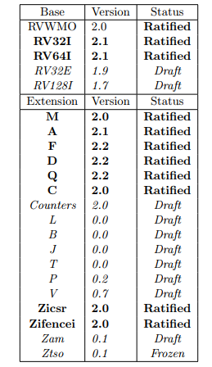
RISCV
Introduction
RISCV
Open ISA
freely available to academia and industry.
Avoids “Over-Architecting” for specific micro-arch/technology
Microcode, In-Order, Decoupled, Out-Of-Order etc.
ASIC, FPGA, full-custom
Small “base” integer ISA
RV32I is usable by itself.
Customizable:
Optional standard extensions.
May add any Non-Standard Extensions.
Idea
LOTR
RC
GPC_4T
Use-Case
Example
Execution
RISCV Tool-Chain
Verilog Simulation
GitHub
Design - RTL
Validation
POC - FPGA

Slide 4
The Architectural idea
Introduction
RISCV
Idea
LOTR
RC
GPC_4T
Use-Case
Example
Execution
RISCV Tool-Chain
Verilog Simulation
GitHub
Design - RTL
Validation
POC - FPGA

Slide 5

Lord-Of-The-Ring
Introduction
RISCV
Idea
LOTR
RC
GPC_4T
Use-Case
Example
Execution
RISCV Tool-Chain
Verilog Simulation
GitHub
Design - RTL
Validation
POC - FPGA

Slide 6
Lord-Of-The-Ring
Introduction
RISCV
Typical Flow:
Load I_MEM
Idea
LOTR
RC
GPC_4T
Use-Case
Example
Execution
RISCV Tool-Chain
Verilog Simulation
GitHub
Design - RTL
Validation
POC - FPGA

Slide 7
Lord-Of-The-Ring
Introduction
RISCV
Typical Flow:
Load I_MEM
Execute Program – Local D_MEM
Idea
LOTR
RC
GPC_4T
Use-Case
Example
Execution
RISCV Tool-Chain
Verilog Simulation
GitHub
Design - RTL
Validation
POC - FPGA

Slide 8
Lord-Of-The-Ring
Introduction
RISCV
Typical Flow:
Load I_MEM
Execute Program – Local D_MEM
Access Non-Local D_MEM
Idea
LOTR
RC
GPC_4T
Use-Case
Example
Execution
RISCV Tool-Chain
Verilog Simulation
GitHub
Design - RTL
Validation
POC - FPGA

Slide 9
Lord-Of-The-Ring
Introduction
RISCV
Other options for Memory Mapped Agent:
Have an “Accelerator–Agent” instead of CORE for specific HW Accelerate calculation.
Idea
LOTR
RC
GPC_4T
Use-Case
Example
Execution
RISCV Tool-Chain
Verilog Simulation
Accelerator
GitHub
Design - RTL
Validation
POC - FPGA

Slide 10
Ring-Controller
Introduction
RISCV
Idea
LOTR
RC
GPC_4T
Use-Case
Example
Execution
RISCV Tool-Chain
Verilog Simulation
GitHub
Design - RTL
Validation
POC - FPGA

Slide 11
Ring-Controller
Introduction
RISCV
Data Path:
Core Request
Idea
LOTR
RC
GPC_4T
Use-Case
Example
Execution
RISCV Tool-Chain
Verilog Simulation
GitHub
Design - RTL
Validation
POC - FPGA

Slide 12
Ring-Controller
Introduction
RISCV
Data Path:
Core Request
Memory Response
Idea
LOTR
RC
GPC_4T
Use-Case
Example
Execution
RISCV Tool-Chain
Verilog Simulation
GitHub
Design - RTL
Validation
POC - FPGA

Slide 13
Ring-Controller
Introduction
RISCV
Data Path:
Core Request
Memory Response
Ring Input
Pass through
Idea
LOTR
RC
GPC_4T
Use-Case
Example
Execution
RISCV Tool-Chain
Verilog Simulation
GitHub
Design - RTL
Validation
POC - FPGA

Slide 14
Ring-Controller
Introduction
RISCV
Data Path:
Core Request
Memory Response
Ring Input
Pass through
F2C RD/WR to local Mem
Idea
LOTR
RC
GPC_4T
Use-Case
Example
Execution
RISCV Tool-Chain
Verilog Simulation
GitHub
Design - RTL
Validation
POC - FPGA

Slide 15
Ring-Controller
Introduction
RISCV
Data Path:
Core Request
Memory Response
Ring Input
Pass through
F2C RD/WR to local Mem
C2F RD_RSP
Idea
LOTR
RC
GPC_4T
Use-Case
Example
Execution
RISCV Tool-Chain
Verilog Simulation
GitHub
Design - RTL
Validation
POC - FPGA

Slide 16
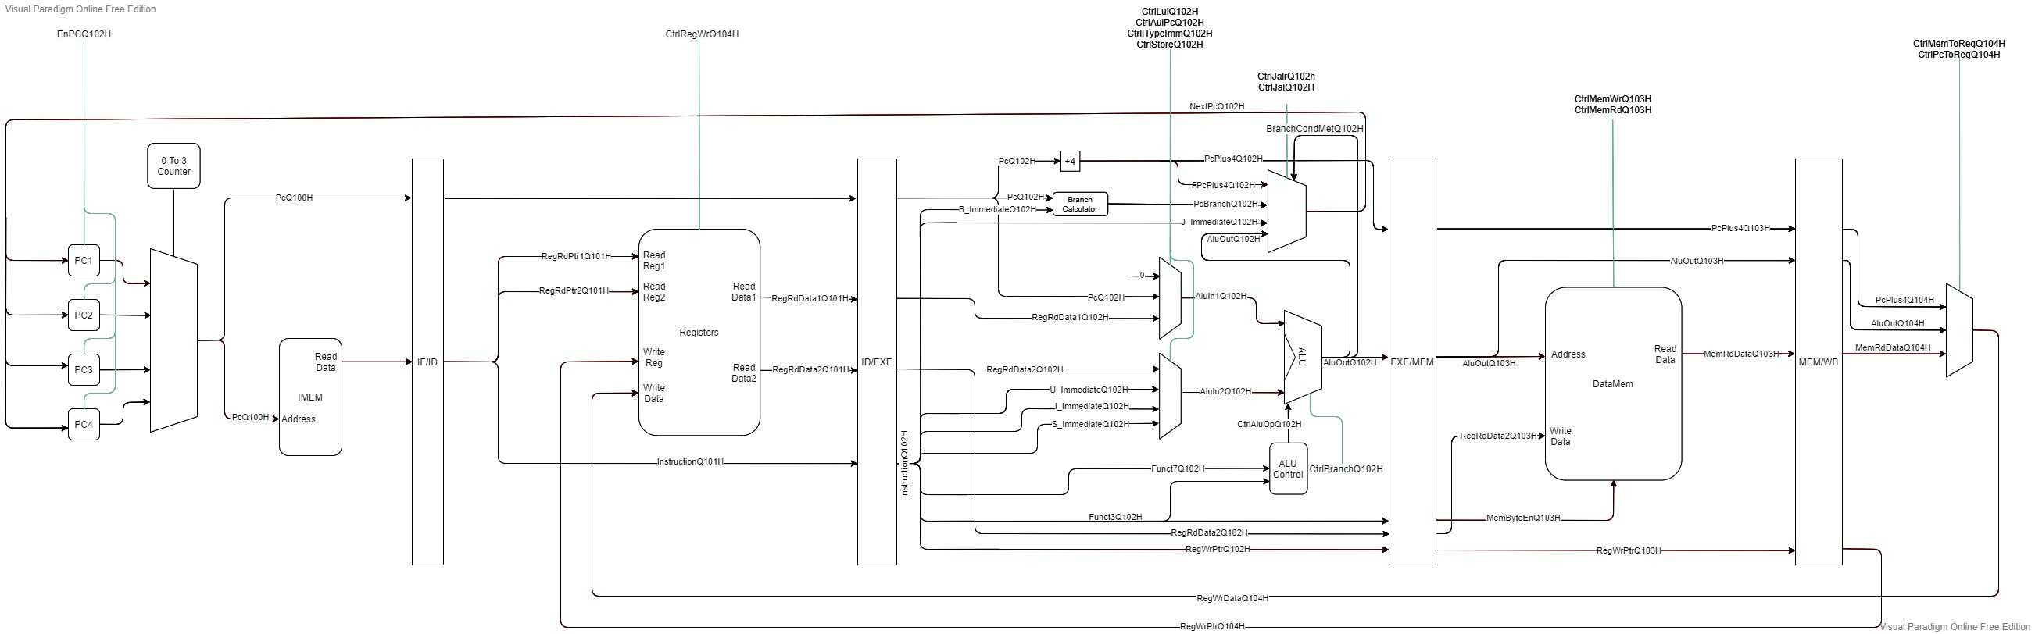
General-Purpose-Compute-Unit With 4 HW Threads
Introduction
RISCV - RV32I/E ISA compatible
RISCV
Idea
LOTR
RC
GPC_4T
Use-Case
Example
Execution
RISCV Tool-Chain
Verilog Simulation
GitHub
Design - RTL
Validation
POC - FPGA

Slide 17
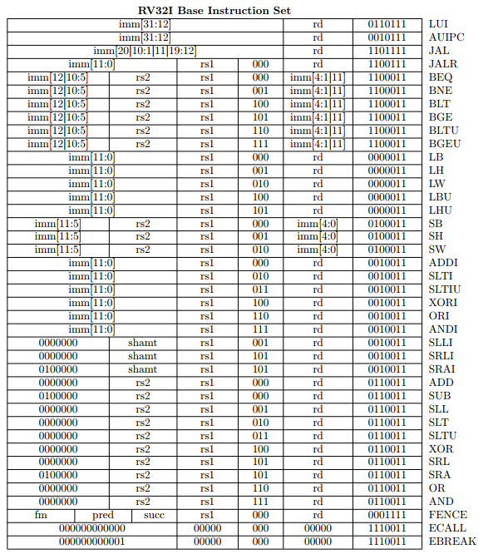
General-Purpose-Compute-Unit With 4 HW Threads
Introduction
RISCV - RV32I/E ISA compatible
RISCV
Idea
LOTR
RC
GPC_4T
Use-Case
Example
Execution
RISCV Tool-Chain
Verilog Simulation
GitHub
Design - RTL
Validation
POC - FPGA

Slide 18
General-Purpose-Compute-Unit With 4 HW Threads
Introduction
RISCV - RV32I/E ISA compatible
5 Stage Pipe-Line
RISCV
Idea
LOTR
RC
GPC_4T
Use-Case
Example
Instruction Fetch
Instruction Decode
Memory Access
Write Back
Execution
Execute
RISCV Tool-Chain
Verilog Simulation
GitHub
Design - RTL
Validation
POC - FPGA

Slide 19
General-Purpose-Compute-Unit With 4 HW Threads
Introduction
RISCV - RV32I/E ISA compatible
5 Stage Pipe-Line
4 HW Threads
4 x Program Counter && 4 x Register Files – See RED
Sharing Execution Logic and Memory Access – See Green
Thread IPC of ¼ - 1 Instruction every 4 Cycles.
RISCV
Idea
LOTR
RC
GPC_4T
Use-Case
Example
Instruction Fetch
Instruction Decode
Memory Access
Write Back
Execution
Execute
RISCV Tool-Chain
Verilog Simulation
GitHub
Design - RTL
Validation
POC - FPGA

Slide 20
General-Purpose-Compute-Unit With 4 HW Threads
Introduction
No Hazards.
No forwarding unit.
No Pipe Flush - no branch predictor.
No Context Switch.
No Interrupts.
No Thread Scheduler
Etc.
RISCV
Idea
LOTR
RC
GPC_4T
Use-Case
Example
Instruction Fetch
Instruction Decode
Memory Access
Write Back
Execution
Execute
RISCV Tool-Chain
Verilog Simulation
GitHub
Design - RTL
Validation
POC - FPGA

Slide 21
Use-Case
Introduction
Programable Accelerators.
Offload tasks from Main processor.
Multi HW Threaded accelerator.
Neural-Network/Machine-Learning.
Encryption - Decryption.
Big-Data.
Image processing
Programable Controllers – Each controller program gets an HW Thread.
RISCV
Idea
LOTR
RC
GPC_4T
Use-Case
Example
Execution
RISCV Tool-Chain
Verilog Simulation
GitHub
Design - RTL
Validation
POC - FPGA

Slide 22
Example: Accelerated Distributed Calculation
Introduction
RISCV
Idea
TODO - code for multi threaded accelerator. Have “switch case” for each Thread and use the CR “WHOAMI” to move Data around the threads and Cores.
LOTR
RC
GPC_4T
Use-Case
Example
Execution
RISCV Tool-Chain
Verilog Simulation
GitHub
Design - RTL
Validation
POC - FPGA

Slide 23
Workflow & Execution
Introduction
RISCV
Idea
LOTR
RC
GPC_4T
Use-Case
Example
Execution
RISCV Tool-Chain
Verilog Simulation
GitHub
Design - RTL
Validation
POC - FPGA

Slide 24
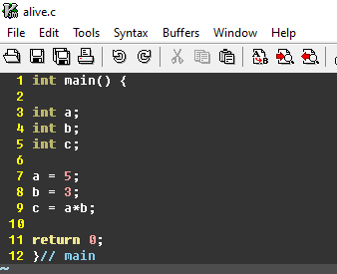
RISCV Tool-Chain
Introduction
RISCV
Idea
C
Compile
Assembly
Linker
Assembler
Machine code
System Verilog
LOTR
RC
GPC_4T
Use-Case
Example
Execution
RISCV Tool-Chain
Verilog Simulation
GitHub
Design - RTL
Validation
POC - FPGA

Slide 25
RISCV Tool-Chain
Introduction
RISCV
Idea
C
Compile
Assembly
Linker
Assembler
Machine code
System Verilog
LOTR
RC
GPC_4T
Use-Case
Example
Execution
RISCV Tool-Chain
Verilog Simulation
GitHub
Design - RTL
Validation
POC - FPGA

Slide 26
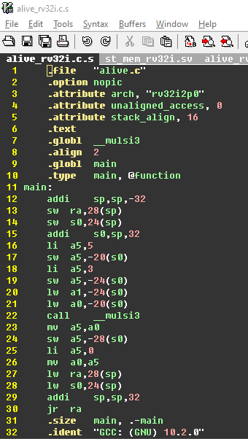
RISCV Tool-Chain
Introduction
RISCV
Idea
C
Compile
Assembly
Linker
Assembler
Machine code
System Verilog
LOTR
RC
GPC_4T
Use-Case
Example
Execution
RISCV Tool-Chain
Verilog Simulation
GitHub
Design - RTL
Validation
POC - FPGA

Slide 27
RISCV Tool-Chain
Introduction
RISCV
Idea
C
Compile
Assembly
Linker
Assembler
Machine code
System Verilog
LOTR
RC
GPC_4T
Use-Case
Example
Execution
RISCV Tool-Chain
Verilog Simulation
GitHub
Design - RTL
Validation
POC - FPGA

Slide 28
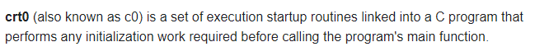
RISCV Tool-Chain
Introduction
RISCV
Idea
C
Compile
Assembly
Linker
Assembler
Machine code
System Verilog
LOTR
RC
GPC_4T
Use-Case
Example
Execution
RISCV Tool-Chain
Verilog Simulation
GitHub
Design - RTL
Validation
POC - FPGA

Slide 29
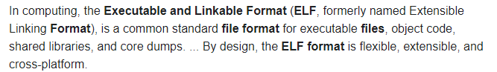
RISCV Tool-Chain
Introduction
RISCV
Idea
C
Compile
Assembly
Linker
Assembler
Machine code
System Verilog
LOTR
RC
GPC_4T
Use-Case
Example
Execution
RISCV Tool-Chain
Verilog Simulation
GitHub
Design - RTL
Validation
POC - FPGA

Slide 30
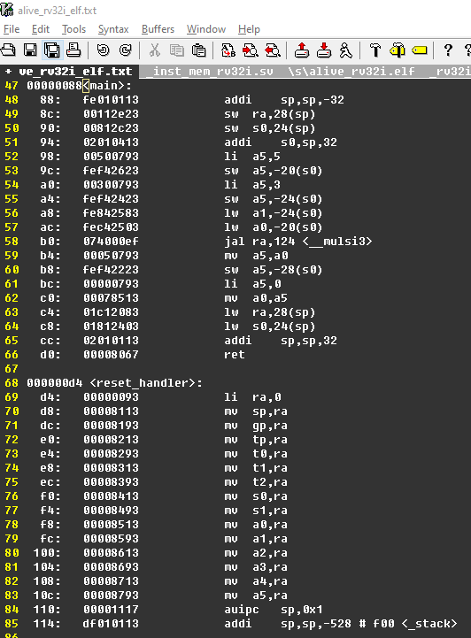
RISCV Tool-Chain
Introduction
RISCV
Idea
C
Compile
Assembly
Linker
Assembler
Machine code
System Verilog
LOTR
RC
GPC_4T
Use-Case
Example
Execution
RISCV Tool-Chain
Verilog Simulation
GitHub
Design - RTL
Validation
POC - FPGA

Slide 31
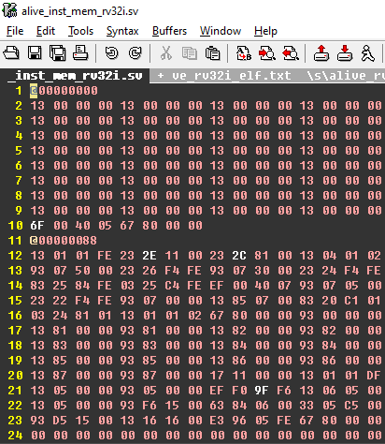
RISCV Tool-Chain
Introduction
RISCV
Idea
C
Compile
Assembly
Linker
Assembler
Machine code
System Verilog
LOTR
RC
GPC_4T
Use-Case
Example
Execution
RISCV Tool-Chain
Verilog Simulation
GitHub
Design - RTL
Validation
POC - FPGA

Slide 32
Verilog Simulation
Windows Environment – using “ModelSim” && “PowerSheel”
Compilation
Elaboration
Simulation
Wave tracker
Memory
Introduction
RISCV
Idea
LOTR
RC
GPC_4T
Use-Case
Example
Execution
RISCV Tool-Chain
Verilog Simulation
GitHub
Design - RTL
Validation
POC - FPGA

Slide 33
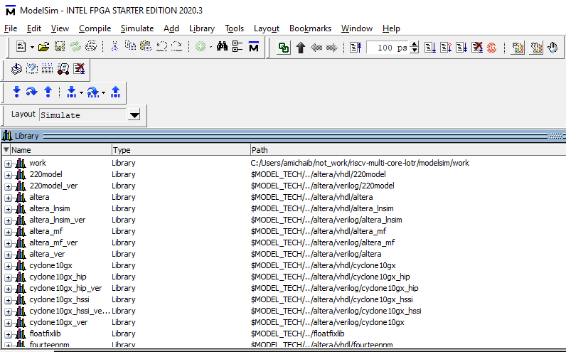
Verilog Simulation
Windows Environment – using “ModelSim” && “PowerShell”
Compilation
Elaboration
Simulation
Wave tracker
Memory
Introduction
RISCV
Idea
LOTR
RC
GPC_4T
Use-Case
Example
Execution
RISCV Tool-Chain
Verilog Simulation
GitHub
Design - RTL
Validation
POC - FPGA

Slide 34
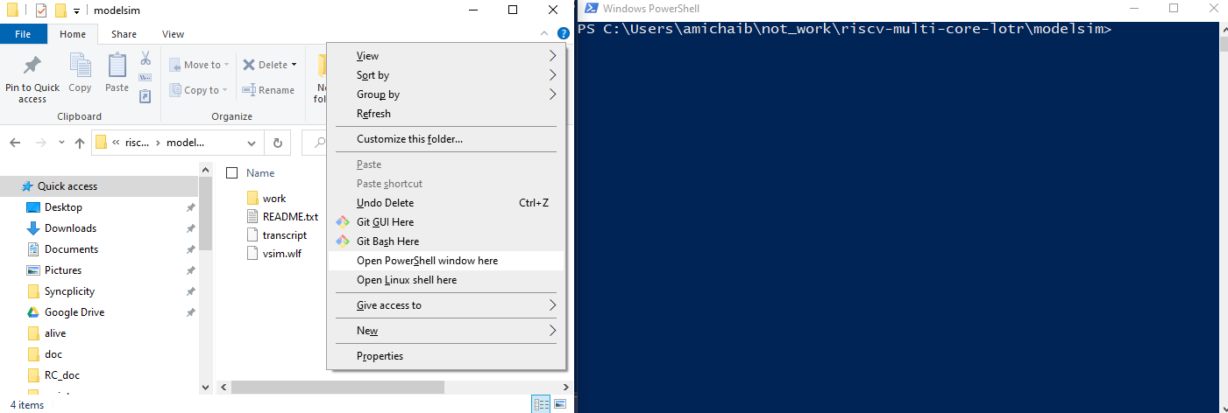
Verilog Simulation
Windows Environment – using “ModelSim” && “PowerShell”
Compilation
Elaboration
Simulation
Wave tracker
Memory
Introduction
RISCV
Idea
LOTR
RC
GPC_4T
Use-Case
Example
Execution
RISCV Tool-Chain
Verilog Simulation
GitHub
Design - RTL
Validation
POC - FPGA

Slide 35
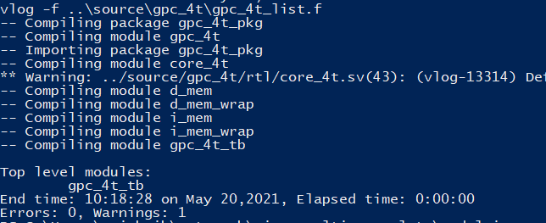
Verilog Simulation
Windows Environment – using “ModelSim” && “PowerShell”
Compilation
Elaboration
Simulation
Wave tracker
Memory
Introduction
RISCV
Idea
LOTR
RC
GPC_4T
Use-Case
Example
Execution
RISCV Tool-Chain
Verilog Simulation
GitHub
Design - RTL
Validation
POC - FPGA

Slide 36
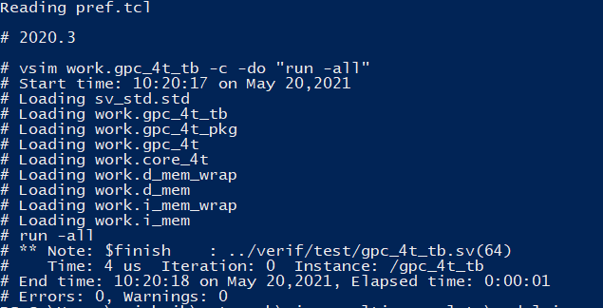
Verilog Simulation
Windows Environment – using “ModelSim” && “PowerShell”
Compilation
Elaboration
Simulation
Wave tracker
Memory
Introduction
RISCV
Idea
LOTR
RC
GPC_4T
Use-Case
Example
Execution
RISCV Tool-Chain
Verilog Simulation
GitHub
Design - RTL
Validation
POC - FPGA

Slide 37
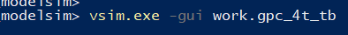
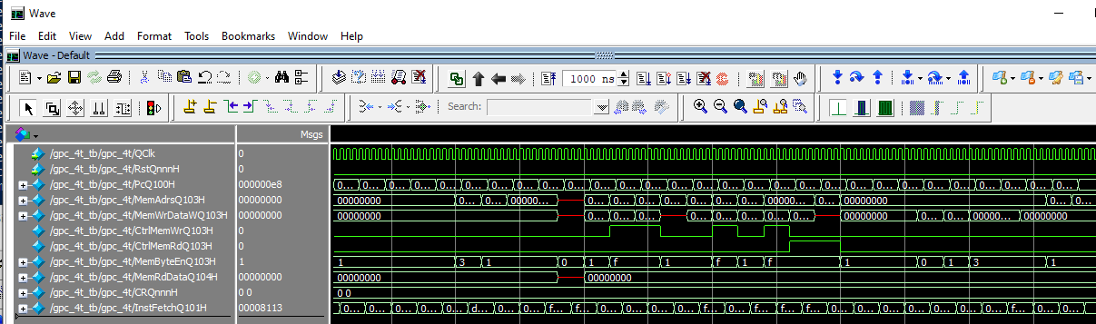
Verilog Simulation
Windows Environment – using “ModelSim” && “PowerShell”
Compilation
Elaboration
Simulation
Wave tracker
Memory
Introduction
RISCV
Idea
LOTR
RC
GPC_4T
Use-Case
Example
Execution
RISCV Tool-Chain
Verilog Simulation
GitHub
Design - RTL
Validation
POC - FPGA

Slide 38
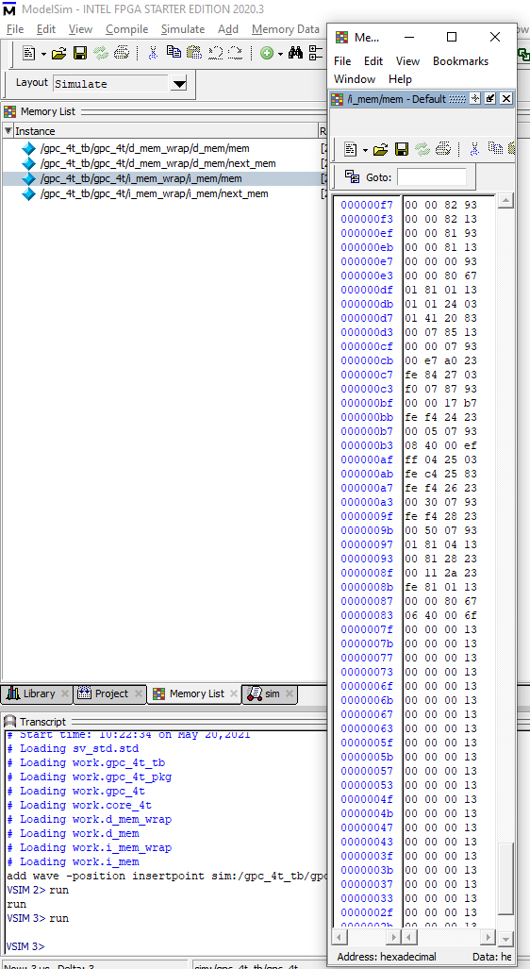
Verilog Simulation
Windows Environment – using “ModelSim” && “PowerShell”
Compilation
Elaboration
Simulation
Wave tracker
Memory
Introduction
RISCV
Idea
LOTR
RC
GPC_4T
Use-Case
Example
Execution
RISCV Tool-Chain
Verilog Simulation
GitHub
Design - RTL
Validation
POC - FPGA

Slide 39

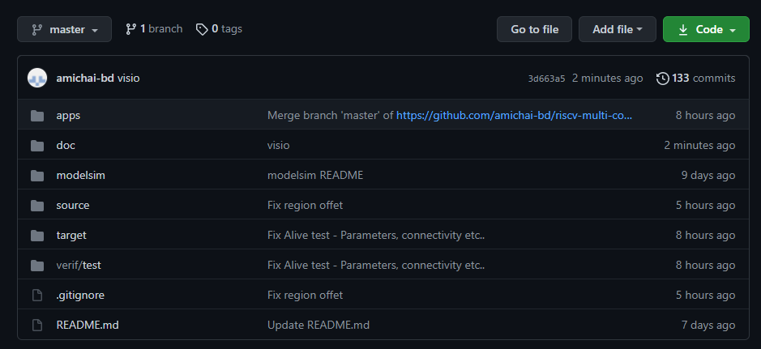
GitHub
https://github.com/amichai-bd/riscv-multi-core-lotr
Introduction
RISCV
Idea
LOTR
RC
GPC_4T
Use-Case
Example
Execution
RISCV Tool-Chain
Verilog Simulation
GitHub
Design - RTL
Validation
POC - FPGA

Slide 40

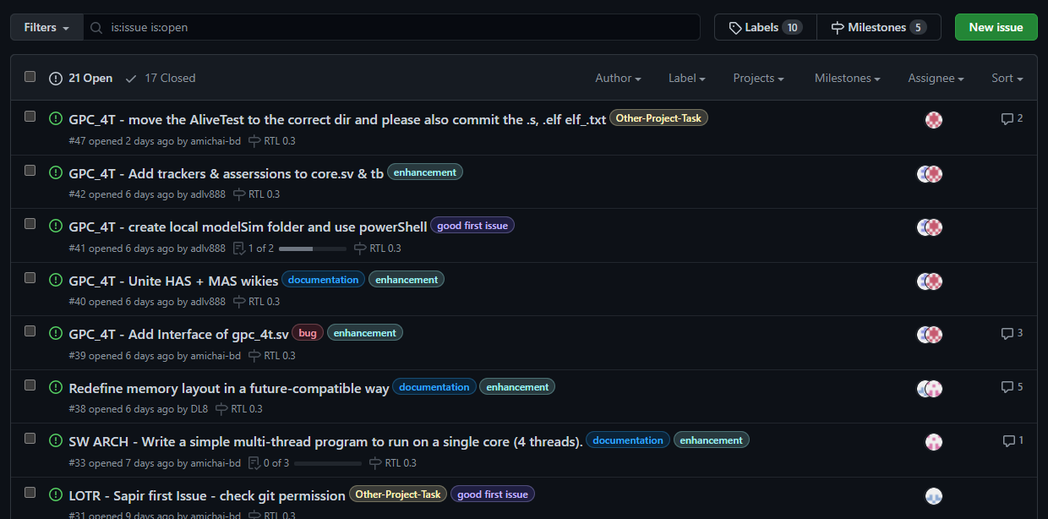
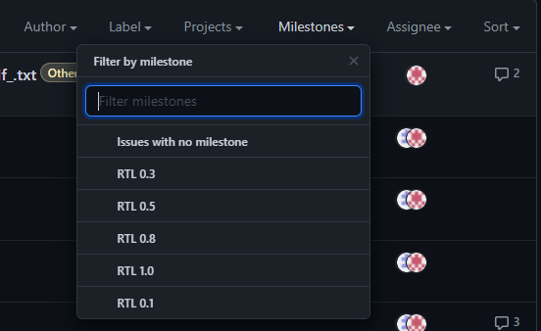
GitHub
https://github.com/amichai-bd/riscv-multi-core-lotr
Introduction
RISCV
Idea
LOTR
RC
GPC_4T
Use-Case
Example
Execution
RISCV Tool-Chain
Verilog Simulation
GitHub
Design - RTL
Validation
POC - FPGA

Slide 41
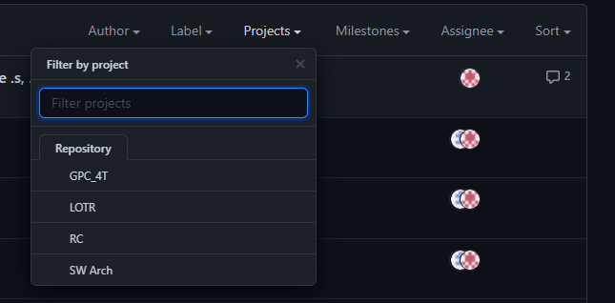
GitHub
https://github.com/amichai-bd/riscv-multi-core-lotr
Introduction
RISCV
Idea
LOTR
RC
GPC_4T
Use-Case
Example
Execution
RISCV Tool-Chain
Verilog Simulation
GitHub
Design - RTL
Validation
POC - FPGA

Slide 42
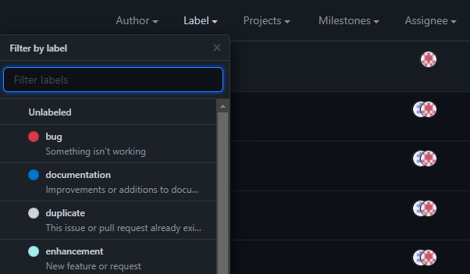
GitHub
https://github.com/amichai-bd/riscv-multi-core-lotr
Introduction
RISCV
Idea
LOTR
RC
GPC_4T
Use-Case
Example
Execution
RISCV Tool-Chain
Verilog Simulation
GitHub
Design - RTL
Validation
POC - FPGA

Slide 43


GitHub
https://github.com/amichai-bd/riscv-multi-core-lotr
Introduction
RISCV
Idea
LOTR
RC
GPC_4T
Use-Case
Example
Execution
RISCV Tool-Chain
Verilog Simulation
GitHub
Design - RTL
Validation
POC - FPGA

Slide 44

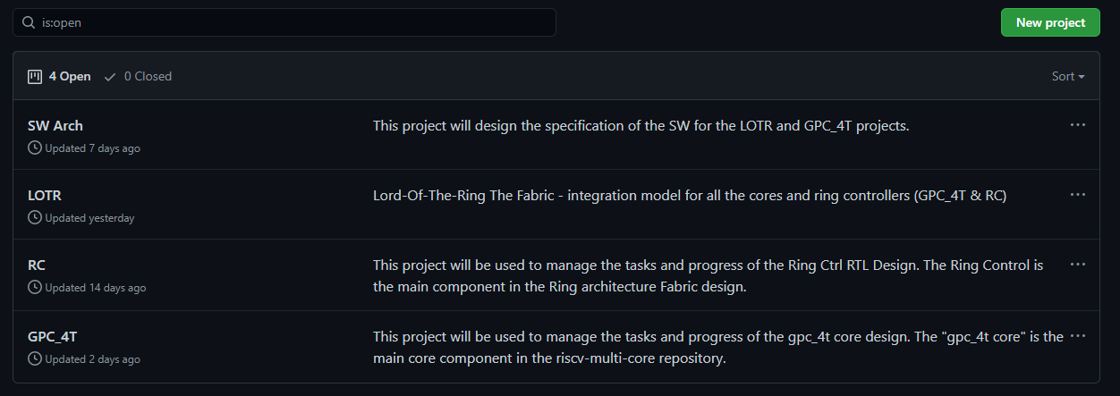
GitHub
https://github.com/amichai-bd/riscv-multi-core-lotr
Introduction
RISCV
Idea
LOTR
RC
GPC_4T
Use-Case
Example
Execution
RISCV Tool-Chain
Verilog Simulation
GitHub
Design - RTL
Validation
POC - FPGA

Slide 45
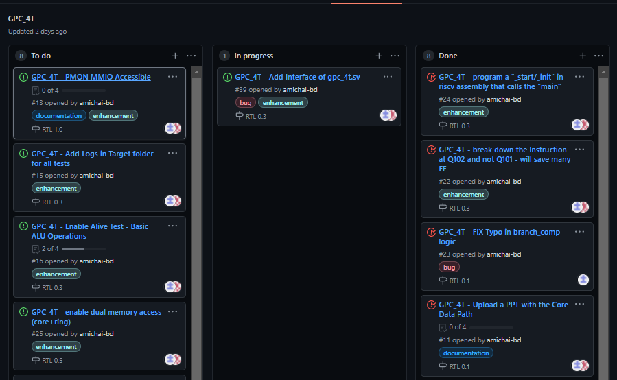
GitHub
https://github.com/amichai-bd/riscv-multi-core-lotr
Introduction
RISCV
Idea
LOTR
RC
GPC_4T
Use-Case
Example
Execution
RISCV Tool-Chain
Verilog Simulation
GitHub
Design - RTL
Validation
POC - FPGA

Slide 46

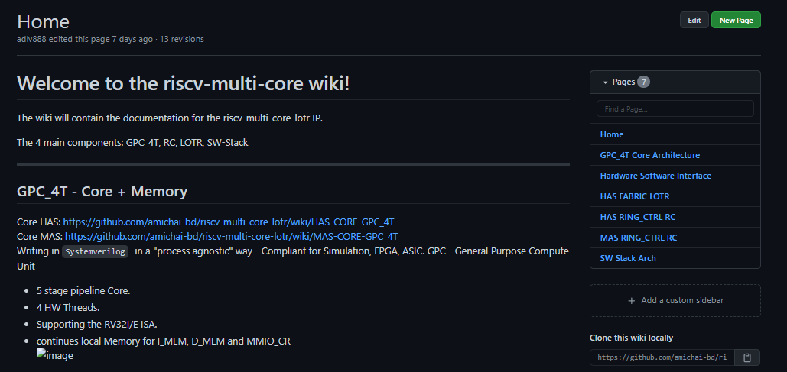
GitHub
https://github.com/amichai-bd/riscv-multi-core-lotr
Introduction
RISCV
Idea
TODO
LOTR
RC
GPC_4T
Use-Case
Example
Execution
RISCV Tool-Chain
Verilog Simulation
GitHub
Design - RTL
Validation
POC - FPGA

Slide 47
Design - RTL
Introduction
RISCV
Idea
Coding Style
Process Agnostic
Design Hierarchy - topology
vlog compile - <IP>.f file per IP
Repository
LOTR
RC
GPC_4T
Use-Case
Example
Execution
RISCV Tool-Chain
Verilog Simulation
GitHub
Design - RTL
Validation
POC - FPGA

Slide 48
Validation
Introduction
RISCV
Idea
Tracker logs
Register Access
Memory Access
ALU input -> output
Parsing results
Memory Array
Tracker Logs
Assertions and errors indications.
All validation TestBanch – the “lotr_tb.sv” stimuli, is done using “C” programs compiled into machine code.
LOTR
RC
GPC_4T
Use-Case
Example
Execution
RISCV Tool-Chain
Verilog Simulation
GitHub
Design - RTL
Validation
POC - FPGA

Slide 49
Proof Of Concept - FPGA
Introduction
RISCV
Idea
TODO
LOTR
RC
GPC_4T
Use-Case
Example
Execution
RISCV Tool-Chain
Verilog Simulation
GitHub
Design - RTL
Validation
POC - FPGA

Slide 51
Question?

Slide 52
